Slide 1
Quality Assurance of Software and Information Systems
Dr. Amira Mohey El-Din

Slide 2
Software Testing Definitions
“Testing is any activity aimed at evaluating an attribute or capability of a program or system and determining that it meets its required results”
Bill Hetzel, 1988

Slide 3
Testing and Debugging
Testing
Systematic exploration of a component or system with the main aim of finding and reporting defects.
Testing does not include correction of defects
Debugging
The process that developers go through to identify the cause of bugs or defects in code and undertake corrections.
May not extend to checking that other areas of the system have not been inadvertently affected by the correction.

Slide 4
Testing Objectives
an indication of quality
requirements conformance
Errors
Notes:
4

Slide 5
What is Testing?
Test activities exist before and after test execution. These activities include:
Planning and control
Choosing test conditions
Designing and executing test cases
Checking results
Evaluating exit criteria
Reporting on the testing process and system under test
Finalizing closure activities after a test phase has been completed.
Reviewing documents (including source code)
Conducting static analysis.

Slide 6
Seven Testing Principles
Principle 1
Principle 2
Principle 3
Principle 4
Principle 5
Principle 6
Principle 7
Testing shows presence of defects.
Exhaustive testing is impossible
Early testing
Defect clustering
Pesticide paradox
Testing is context dependent
Absence-of-errors fallacy

Slide 7
Principle 1- Testing shows presence of defects.
but cannot prove that there are no defects.
tests should be designed to find as many defects as possible.
Notes:
Principle 1 – Testing shows presence of defects
Testing can show that defects are present, but cannot prove that there are no defects. Testing
reduces the probability of undiscovered defects remaining in the software but, even if no defects are
found, it is not a proof of correctness.

Slide 8
Principle 2- Exhaustive testing is impossible
What is exhaustive testing?
when all the testers are exhausted
when all the planned tests have been executed
exercising all combinations of inputs and preconditions
How much time will exhaustive testing take?
infinite time
not much time
impractical amount of time
Notes:
Principle 2 – Exhaustive testing is impossible
Testing everything (all combinations of inputs and preconditions) is not feasible except for trivial
cases. Instead of exhaustive testing, risk analysis and priorities should be used to focus testing
efforts.
Consider a small piece of software where one can enter a password, specified to contain up to three characters, with no consecutive repeating entries. Using only western alphabetic capital letters and completing all three characters, there are 26 × 26 × 26 input permutations (not all of which will be valid). However, with a standard keyboard, there are not 26 × 26 × 26 permutations, but a much higher number, 256 × 256 × 256, or 2^24.

Slide 9
Principle 3- Early testing
$ 25
Notes:
Principle 3 – Early testing
To find defects early, testing activities shall be started as early as possible in the software or system
development life cycle, and shall be focused on defined objectives.

Slide 10
Principle 4- Defect clustering
A small number of modules usually contains most of the defects discovered during prerelease testing, or is responsible for most of the operational failures.
This can be for a variety of reasons, some of which are:
System complexity.
Volatile code.
The effects of change upon change.
Development staff experience.
Development staff inexperience.
Notes:
Principle 4 – Defect clustering
Testing effort shall be focused proportionally to the expected and later observed defect density of modules.
There may be fewer defects in the remaining code, but testers still need to search diligently for them.

Slide 11
Principle 5- Pesticide paradox
If the same tests are repeated over and over again, eventually the same set of test cases will no longer find any new defects.
To overcome this “pesticide paradox”, test cases need to be regularly reviewed and revised, and new and different tests need to be written to exercise different parts of the software or system to find potentially more defects.
Notes:
Principle 5 – Pesticide paradox
If the same tests are repeated over and over again, eventually the same set of test cases will no longer find any new defects. To overcome this “pesticide paradox”, test cases need to be regularly
reviewed and revised, and new and different tests need to be written to exercise different parts of
the software or system to find potentially more defects.

Slide 12
Principle 6- Testing is context dependent
Testing is done differently in different contexts.
For example, safety-critical software is tested differently from an e-commerce site.
Risk can be a large factor in determining the type of testing that is needed.
The higher the possibility of losses, the more we need to invest in testing the software before it is implemented.
Notes:
Principle 6 – Testing is context dependent
Testing is done differently in different contexts. For example, safety-critical software is tested
differently from an e-commerce site.

Slide 13
Principle 7- Absence-of-errors fallacy
Finding and fixing defects does not help if the system built is unusable and does not fulfill the users’ needs and expectations.
Notes:
Principle 7 – Absence-of-errors fallacy
Finding and fixing defects does not help if the system built is unusable and does not fulfill the users’ needs and expectations.
Before dynamic testing has begun, there are no defects reported against the code delivered. Does this mean that software that has not been tested (but has no outstanding defects against it) can be shipped? We think not!

Slide 14
VV&T
Verification
The process of evaluating a system or component to determine whether the products of the given development phase satisfy the conditions imposed at the start of that phase
Validation
Determination of the correctness of the products of software development with respect to the user needs and requirements
Testing
The process of exercising software to verify that it satisfies specified requirements and to detect faults

Slide 15
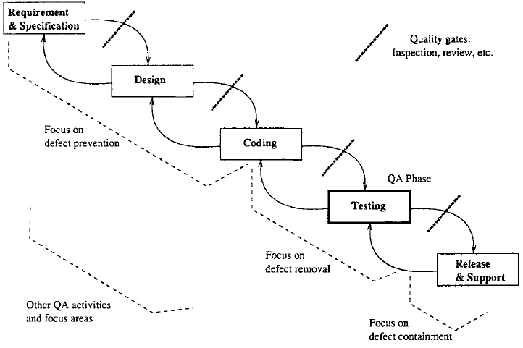
Waterfall Model

Slide 16
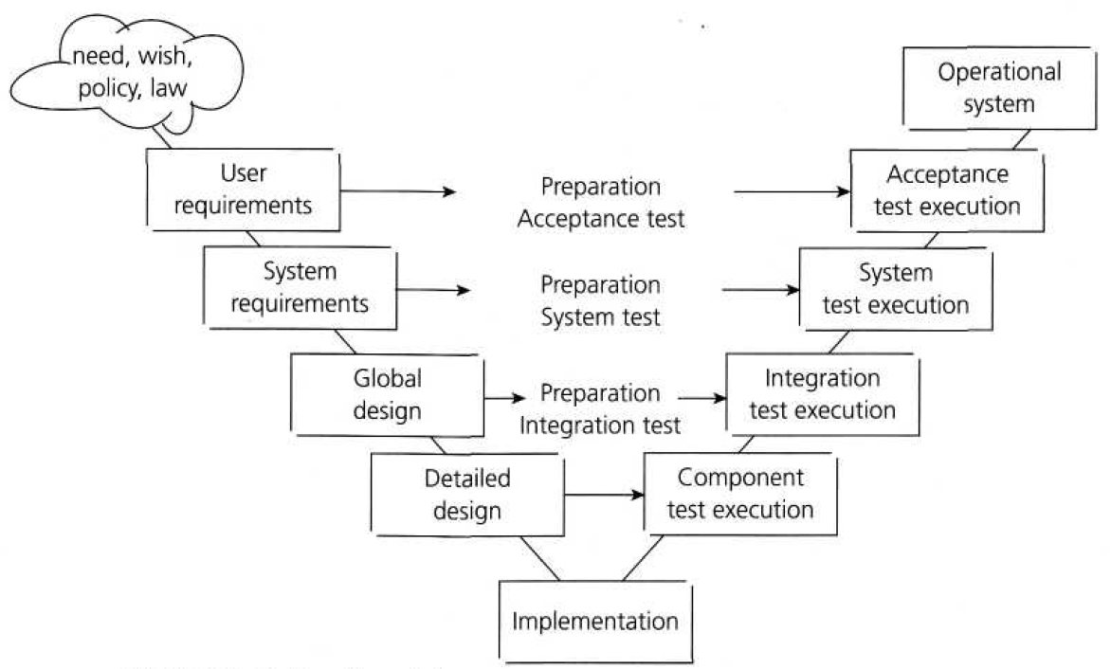
V-model (Sequential Development Model)

Slide 17
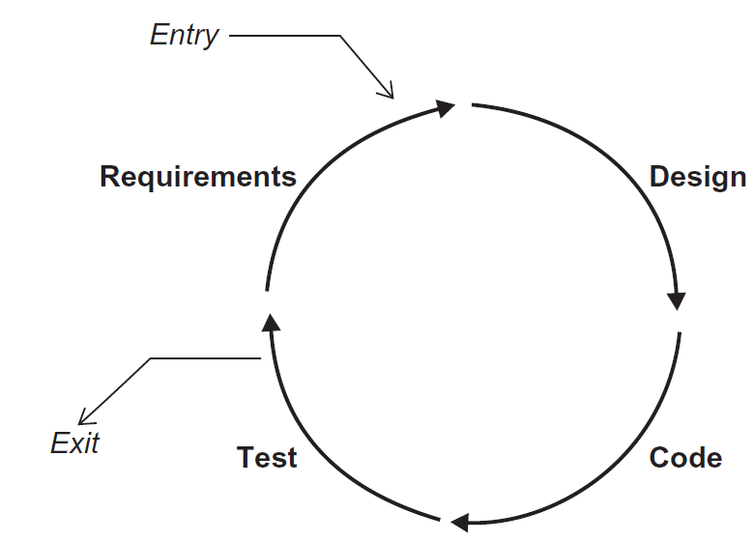
Iterative-incremental Development Models
E.g. :
Agile
Extreme programming (XP)
Scrum
Rapid Application Development (RAD)
Lack of formal documentation
Test-driven development
Hard to track developer changes
Configuration management
Notes:
Iterative-incremental Development Models
Iterative-incremental development is the process of establishing requirements, designing, building
and testing a system, done as a series of shorter development cycles. Examples are: prototyping,
Rapid Application Development (RAD), Rational Unified Process (RUP) and agile development

Slide 18
Testing Levels
Unit (component) testing
Unit Integration testing
System testing
System Integration testing
Acceptance testing

Slide 19
Test Levels : 1. Unit (component) Testing
lowest level
Goal: to isolate each part of the program & show that the individual parts are correct.
Unit testing is intended to ensure that the code written for the unit meets its specification, prior to its integration with other units.
Units could be :Components, Programs, Data conversion / migration programs
also known as unit, module, program testing.
Performed by programmer.

Slide 20
Test Levels : 2. Integration Testing
more than one (tested) component
Goal: to integrate some dependent units to check correctness of communication & data formats among them.
non-functional aspects if possible
Performed by programmer, designers, analysts, or independent testers

Slide 21
Test Levels: 3. System Testing
System testing is concerned with the behavior of a whole system/product. The testing scope shall be clearly addressed in the Master and/or Level Test Plan for that test level.
In system testing, the test environment should correspond to the final target or production environment as much as possible in order to minimize the risk of environment-specific failures not being found in testing.
Goal: is the system testing complete software product.
Performed by Test Team

Slide 22
Test Levels: 4. System Integration Testing
Goal: to check that system is ok when trade with other system.
Performed by Test Team
Examples:
LAN / WAN, communications middleware
other internal systems (billing, stock, personnel, overnight batch, branch offices, other countries)
external systems (stock exchange, news, suppliers)
intranet, internet / www
3rd party packages
electronic data interchange (EDI)

Slide 23
Test Levels: 5 . Acceptance Testing
Acceptance testing is often the responsibility of the customers or users of a system.
Goal: is to establish confidence in the system, parts of the system or specific non-functional characteristics of the system.
Example
User Acceptance testing
Operational Acceptance testing
Contract and regulation acceptance testing

Slide 24
Testing Types
Functional testing (check function)
Non-functional testing (check feature related to usage such as: Accessibility, usability, performance, security)

Slide 25
Functional Testing
The functions are “what” the system does.
May be described in work products such as a requirements specification, use cases, or a functional specification.
Functional tests may be performed at all test levels (e.g., tests for components may be based on a component specification).
Specification-based techniques may be used to derive test conditions and test cases from the functionality of the software or system.
A type of functional testing, security testing, investigates the functions (e.g., a firewall) relating to detection of threats.

Slide 26
2. Non-Functional Testing
It is the testing of “how” the system works.
Non-functional testing includes performance testing, load testing, stress testing, usability testing, maintainability testing, reliability testing and portability testing.
Non-functional testing may be performed at all test levels.
These tests can be referenced to a quality model such as the one defined in ‘Software Engineering – Software Product Quality’ (ISO 9126).

Slide 27
THANK YOU

